Slide 1





Slide 2


Slide 3
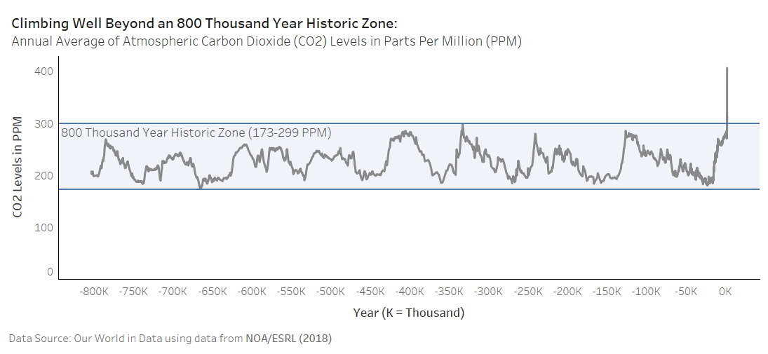


Slide 4
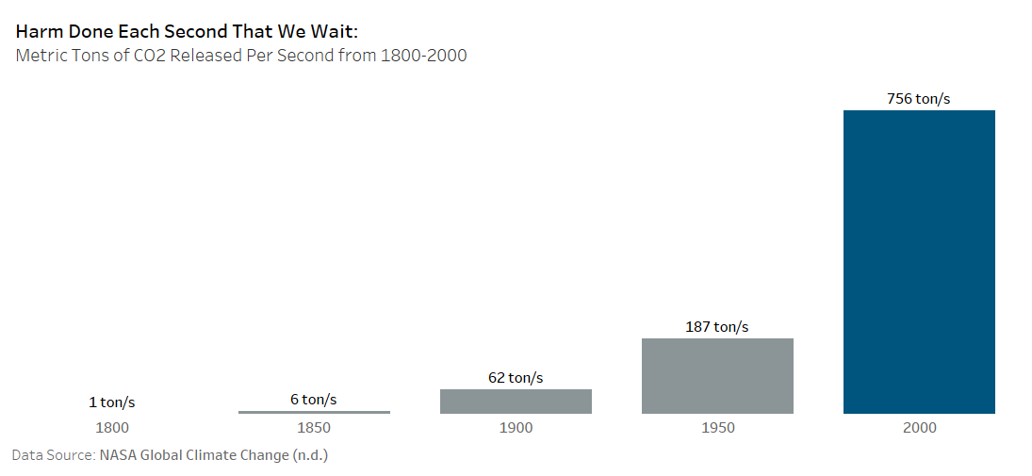

Slide 5
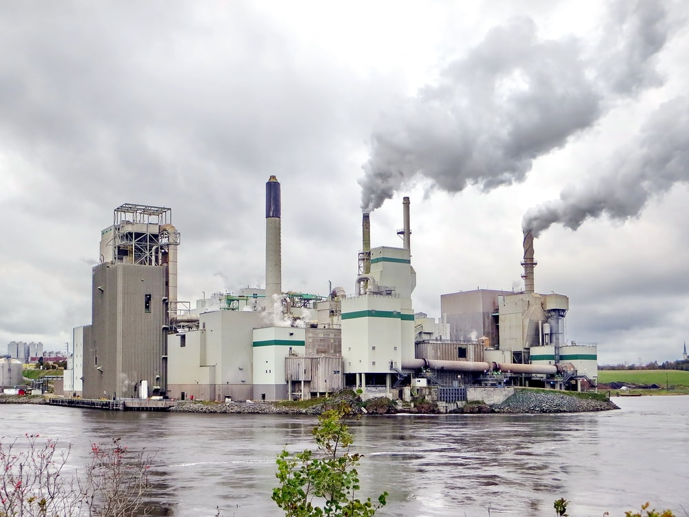
Burning Fossil Fuels

Slide 6
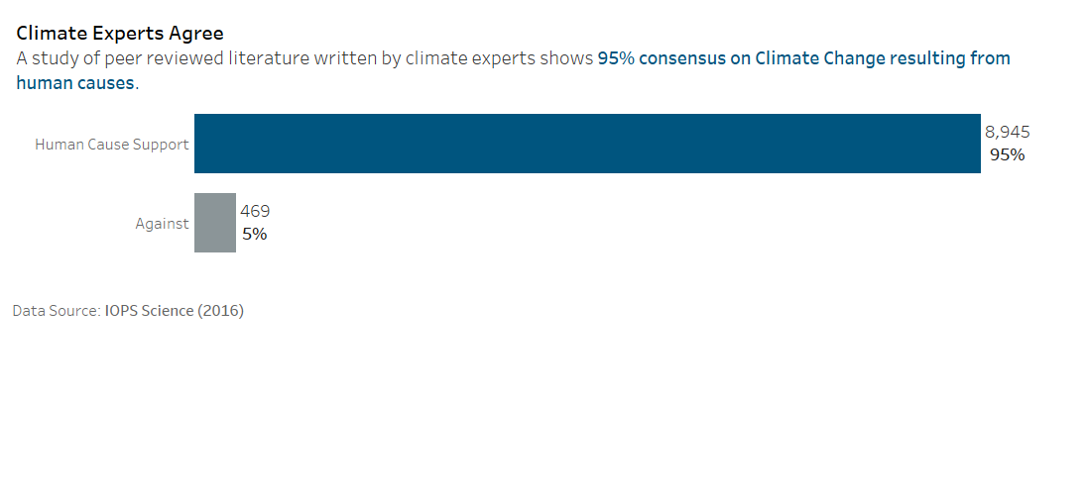

Slide 7
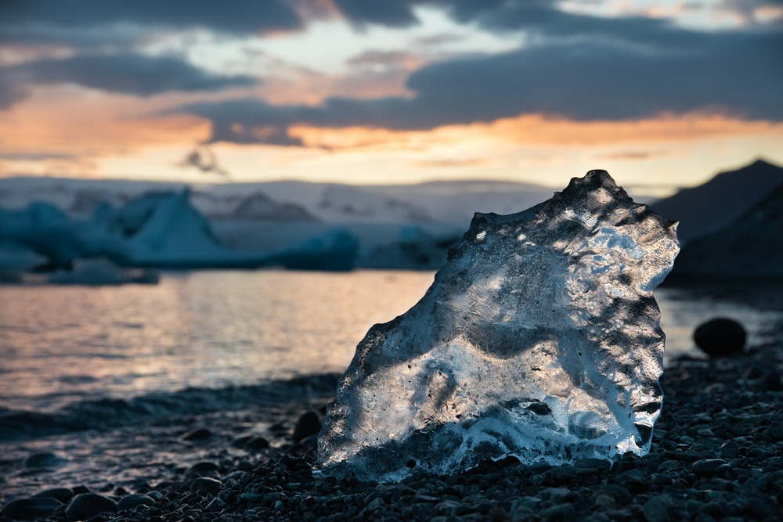
Sea Levels Rise as Oceans Heat Up

Slide 8
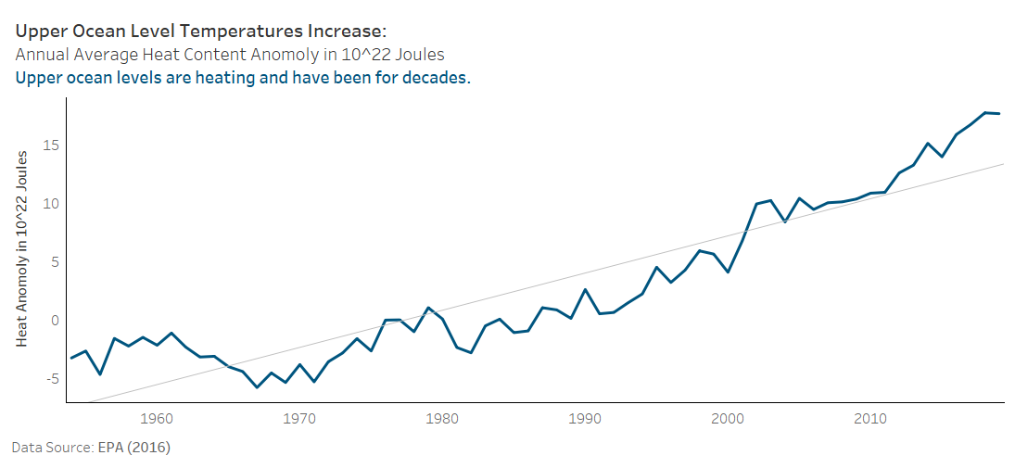

Slide 9
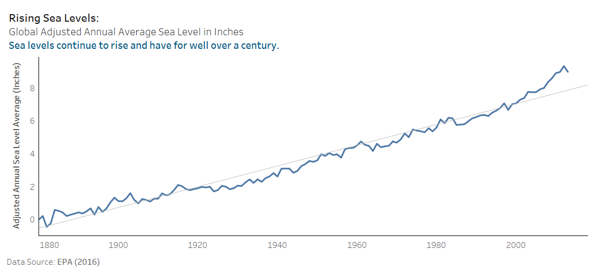

Slide 10
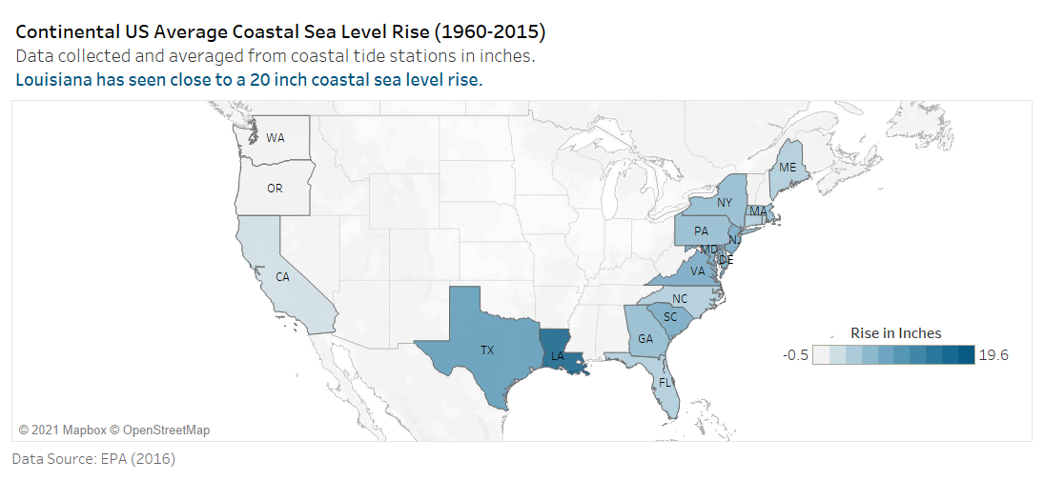

Slide 11
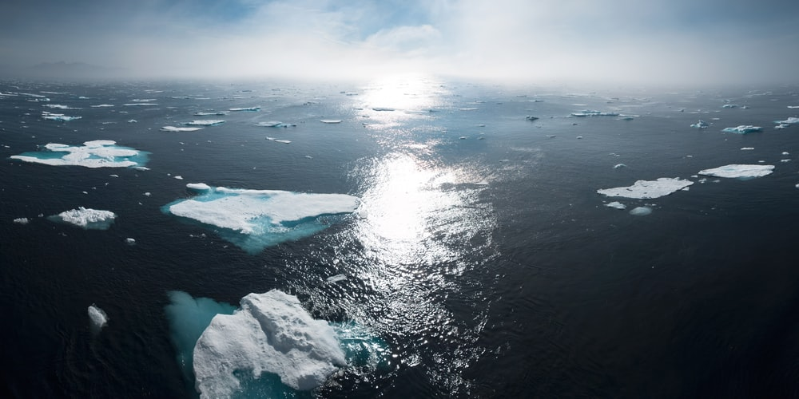
Arctic Ice Melts

Slide 12
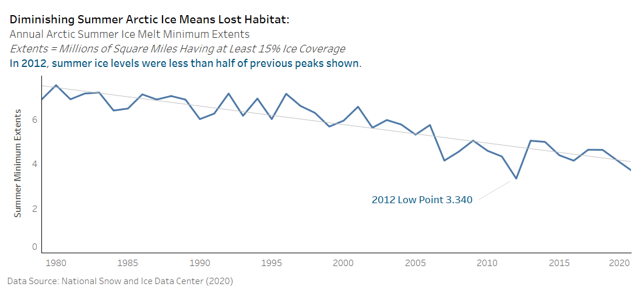

Slide 13
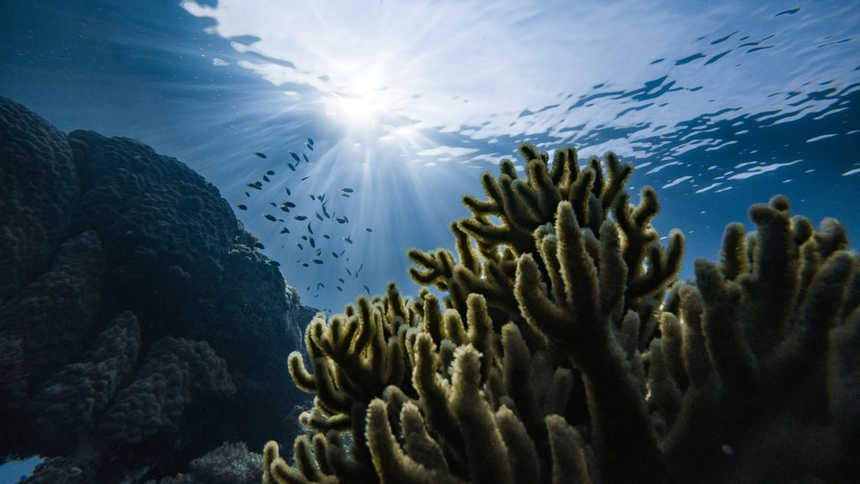
Lower PH Damages Coral Reefs
Oceans 12.7% more acidic from 1985 to 2018

Slide 14

Purchase Fuel Efficient Vehicles
Learn About Your Carbon Footprint
Contact Your Government Officials
Demand Action

Slide 15
Thank you for your attention!
As promised, I kept it short.
By
Sam Loyd

